Slide 1
Complications of Sinusitis

Slide 2
Three main categories
Orbital (60-75%)
Intracranial (15-20%)
Bony (5-10%)
Radiography
Computed tomography (CT) best for orbit
Magnetic resonance imaging (MRI) best for intracranium

Slide 3
Orbital
Most commonly involved complication site
Proximity to ethmoid sinuses
Periorbita/orbital septum is the only soft-tissue barrier
Valveless superior and inferior ophthalmic veins

Slide 4
Direct extension through lamina papyracea
Impaired venous drainage from thrombophlebitis
Progression within 2 days
Children more susceptible
< 7 years – isolated orbital (subperiosteal abscess)
> 7 years – orbital and intracranial complications

Slide 5
Orbital Complications
Chandler Criteria
Preseptal cellulitis
Orbital cellulitis
Subperiosteal abscess
Orbital abscess
Cavernous sinus thrombosis

Slide 6
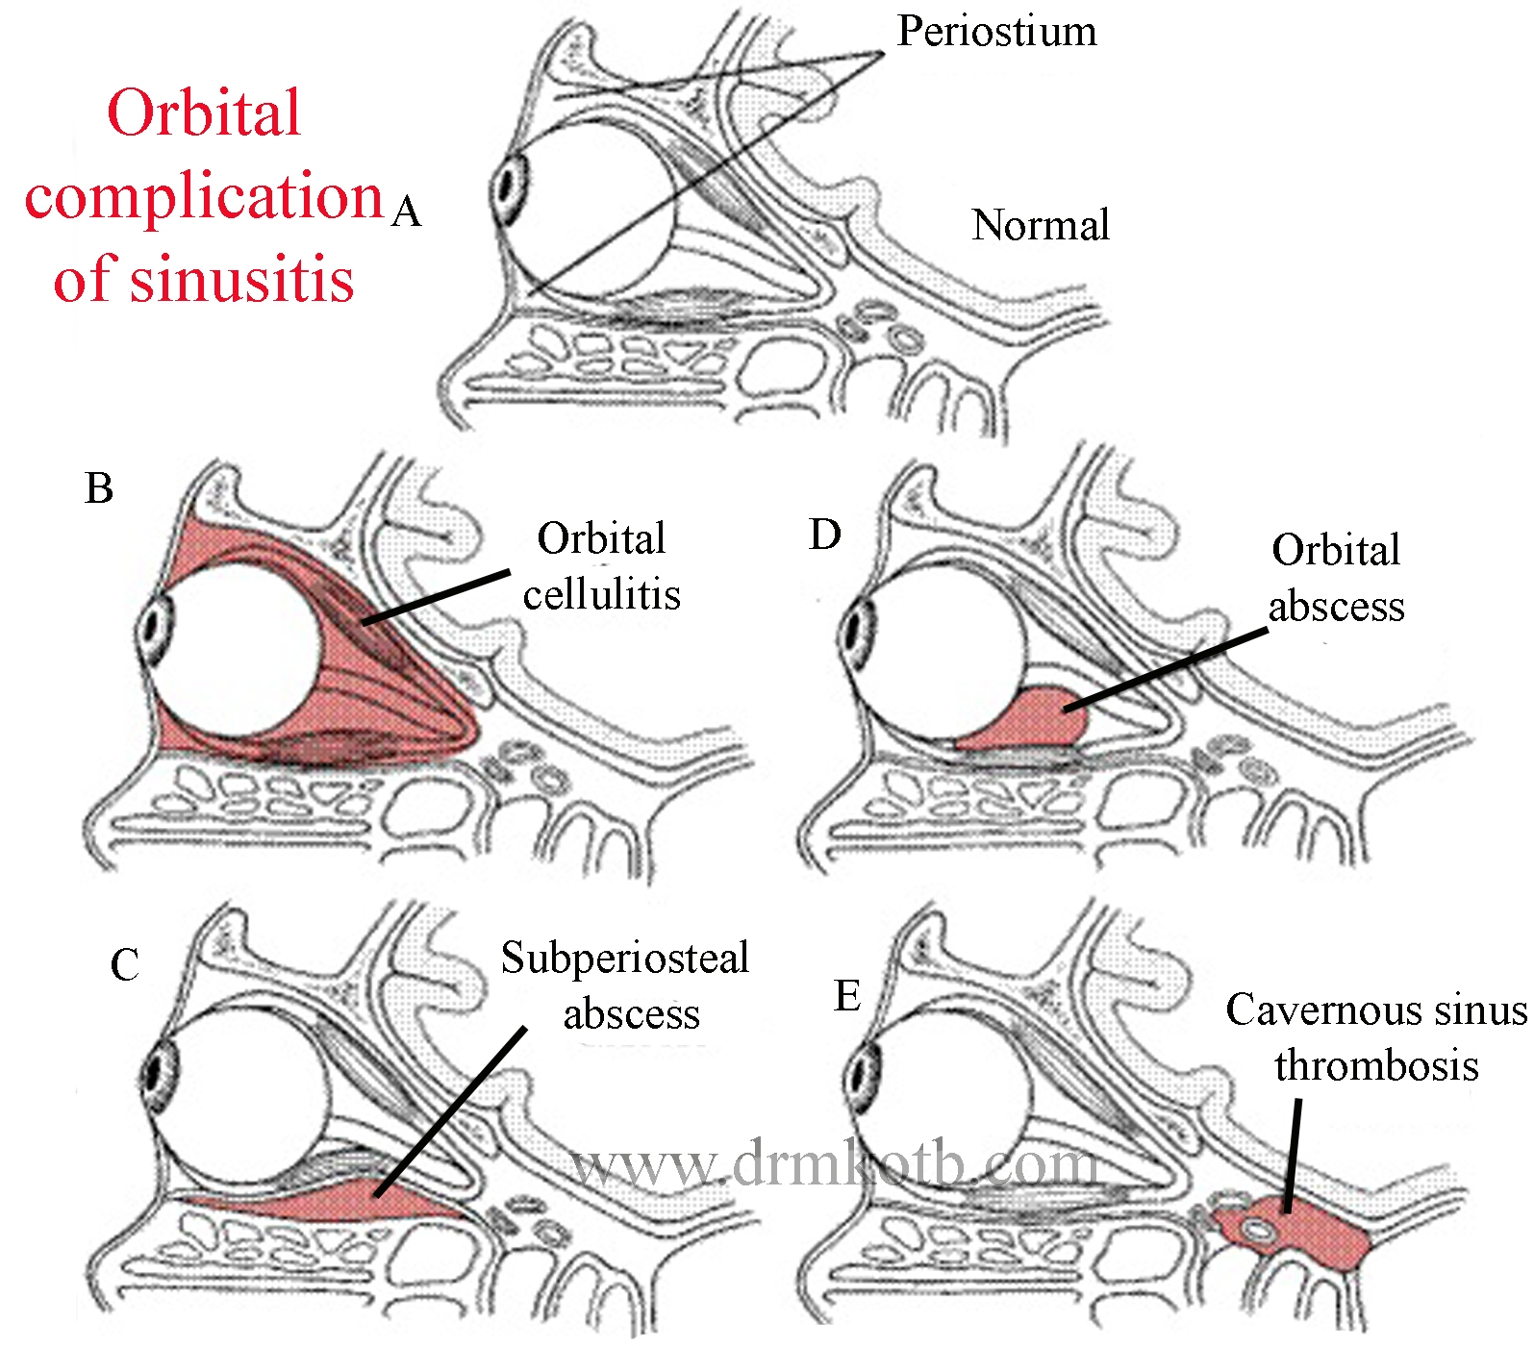

Slide 7
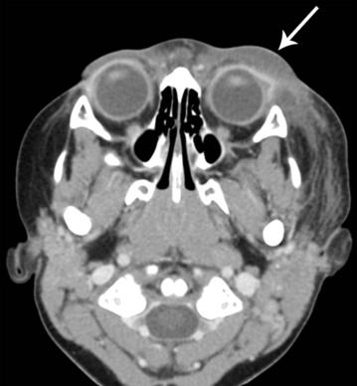
Preseptal cellulitis
Symptomatology
Eyelid edema and erythema
Extraocular movement intact
Normal vision
May have eyelid abscess
CT reveals diffuse thickening of lid and conjunctiva

Slide 8
Treatment
Medical therapy typically sufficient
Intravenous antibiotics
Head of bed elevation
Warm compresses
Facilitate sinus drainage
Nasal decongestants
Mucolytics
Saline irrigation

Slide 9
Orbital cellulitis
Symptomatology
Post-septal infection
Eyelid edema and erythema
Proptosis and chemosis
Limited or no extraocular movement limitation
No visual impairment
No discrete abscess
Low-attenuation adjacent to lamina papyracea on CT

Slide 10
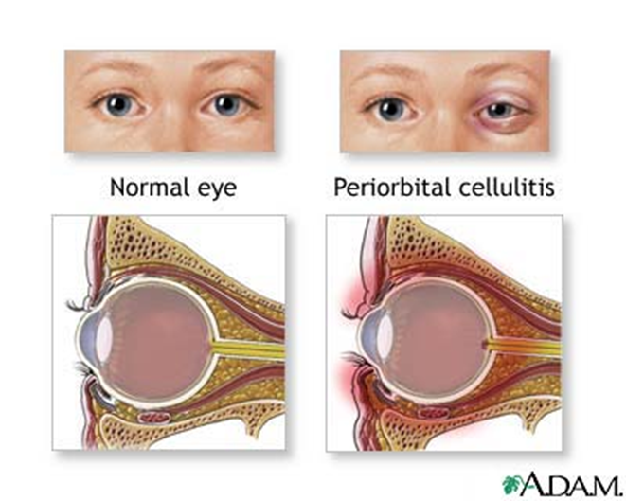

Slide 11
Facilitate sinus drainage
Nasal decongestants
Mucolytics
Saline irrigations
Medical therapy typically sufficient
Intravenous antibiotics
Head of bed elevation
Warm compresses
May need surgical drainage
Visual acuity 20/60 or worse
No improvement or progression within 48 hours

Slide 12
Feature | Preseptal Cellulitis | Orbital Cellulitis
Proptosis | Absent | Present
Motility | Normal | Decreased
Pain on motion | Absent | Present
Orbital pain | Absent | Present
Vision | Normal | May be decreased
Pupillary reaction | Normal | May be abnormal; ± afferent pupillary defect
Chemosis | Rare | Common
Corneal sensation | Normal | May be reduced
Ophthalmoscopy | Normal | May be abnormal; ± venous congestion; ± disc edema
Systemic signs (e.g., fever, malaise) | Mild | Commonly severe

Slide 13
Subperiosteal Abscess
Pus formation between periorbita and lamina papyracea Displace orbital contents downward and laterally
Proptosis, chemosis, ophthalmoplegia
Risk for residual visual sequelae
May rupture through septum and present in eyelids

Slide 14
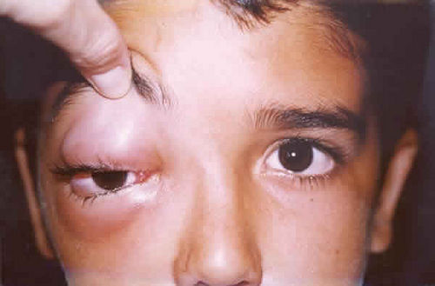

Slide 15
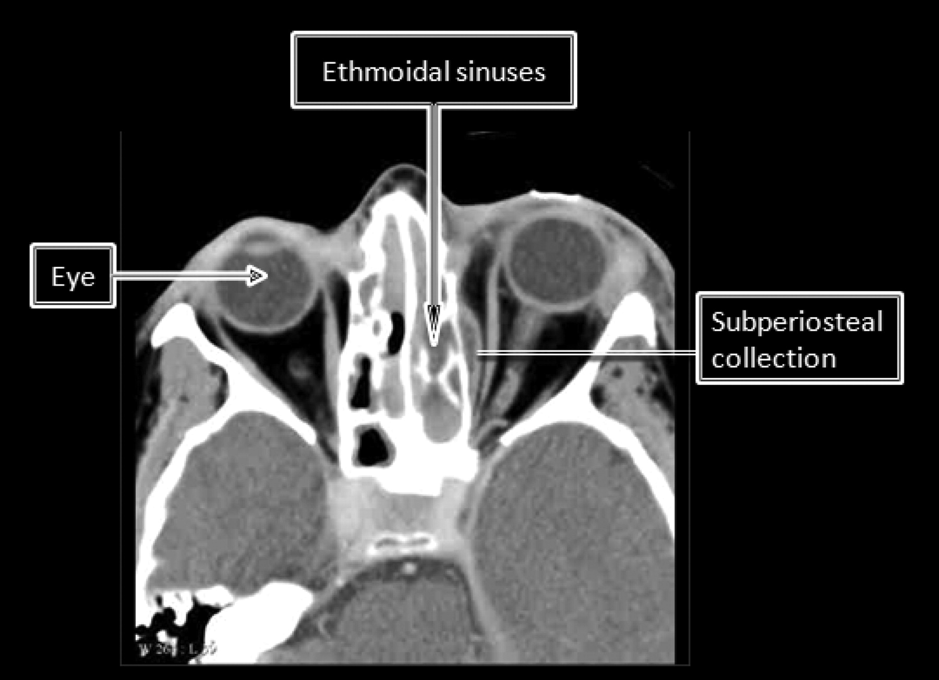

Slide 16
Surgical drainage
Worsening visual acuity or extraocular movement
Lack of improvement after 48 hours
May be treated medically in 50-67%
Meta-analysis cure rate 26-93%
Combined treatment 95-100%

Slide 17
Open ethmoids and remove lamina papyracea
Approaches
External ethmoidectomy (Lynch
incision)is most preferred
Endoscopic ideal for medial abscesses
Transcaruncular approach
Transconjunctival incision
Extend medially around lacrimal caruncle

Slide 18
Orbital Abscess
Pus formation within orbital tissues
Severe exophthalmos and chemosis
Ophthalmoplegia
Visual impairment
Risk for irreversible blindness
Can spontaneously drain through eyelid

Slide 19
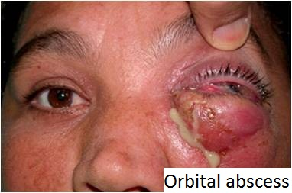

Slide 20
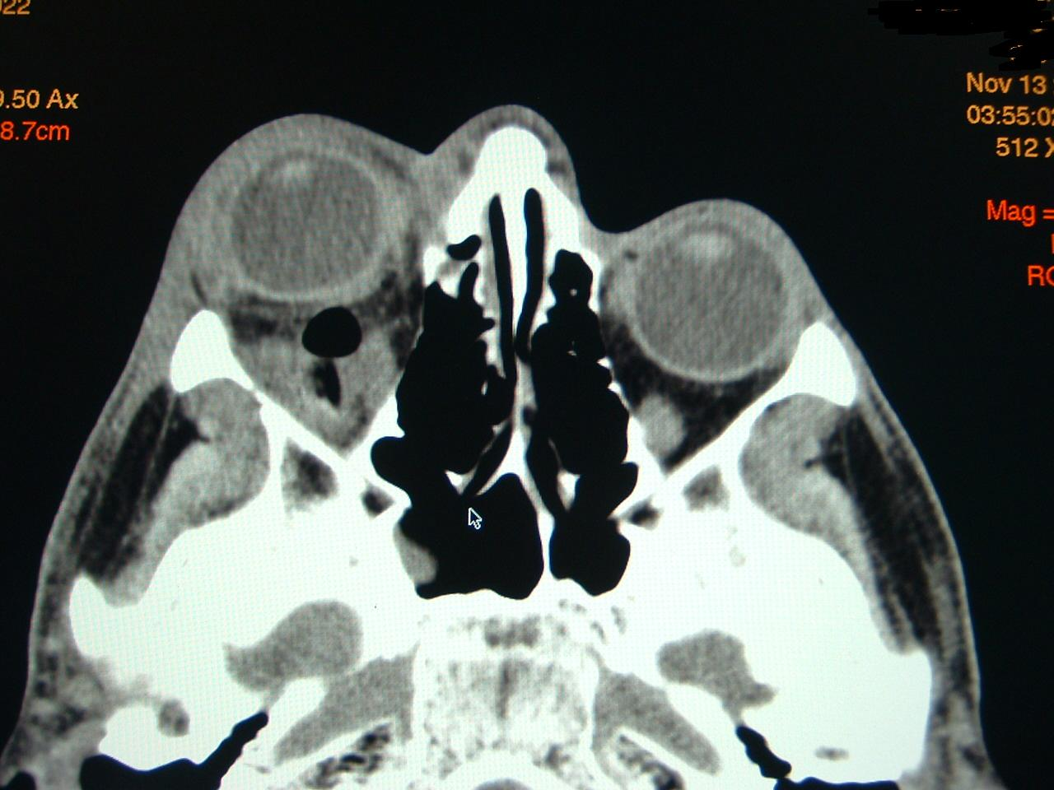

Slide 21
Incise periorbita and drain intraconal abscess
Similar approaches as with subperiosteal abscess
Lynch incision
Endoscopic

Slide 22
Cavernous Sinus Thrombosis
Symptomatology
Orbital pain
Proptosis and chemosis
Ophthalmoplegia
Symptoms in contralateral eye
Associated with sepsis and meningismus
Radiology
Poor venous enhancement on CT
Better visualized on MRI

Slide 23
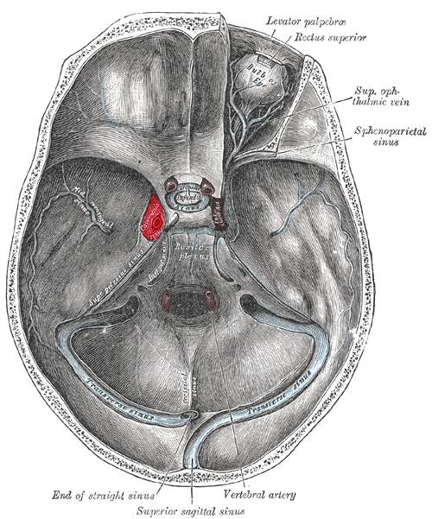

Slide 24
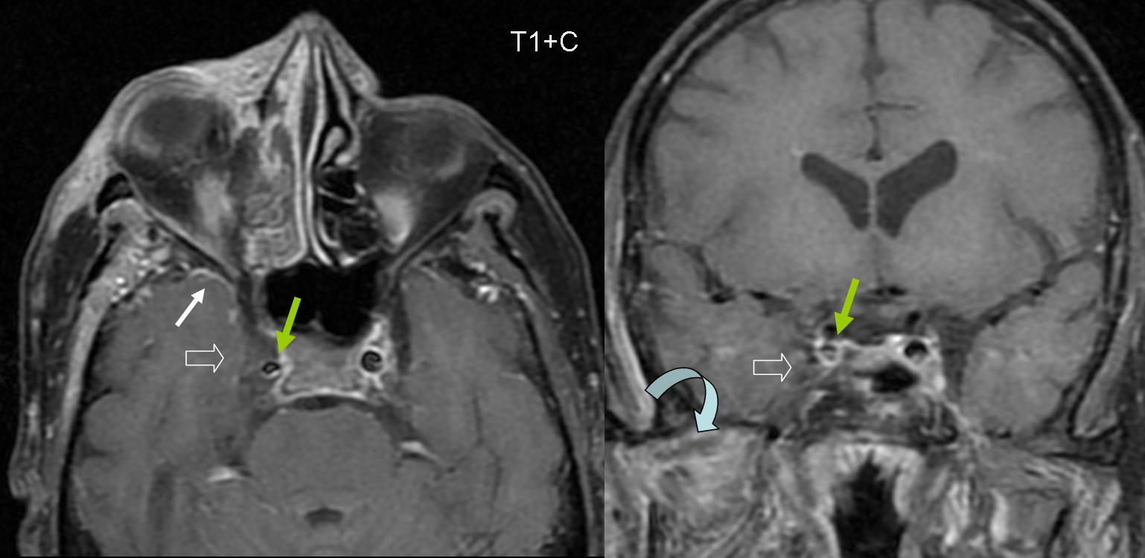

Slide 25
Intracranial complications

Slide 26
Occurs more commonly in CRS
Mucosal scarring, polypoid changes
Hidden infectious foci with poor antibiotic penetration
Male teenagers affected more than children

Slide 27
Direct extension
Sinus wall erosion
Traumatic fracture lines
Neurovascular foramina (optic and olfactory nerves)
Hematogenous spread
Diploic skull veins
Ethmoid bone

Slide 28
Meningitis
Epidural abscess
Subdural abscess
Intracerebral abscess
Cavernous sinus, venous sinus thrombosis

Slide 29
Fever (92%)
Headache (85%)
Nausea, vomiting (62%)
Altered consciousness (31%)
Seizure (31%)
Hemiparesis (23%)
Visual disturbance (23%)
Meningismus (23%)

Slide 30
Meningitis
Headache,meningismus
Fever, septic
Cranial nerve palsies
Sinusitis is unusual cause of meningitis, Sphenoiditis, Ethmoiditis
Usually amenable with medical treatment
Drain sinuses if no improvement after 48 hours
Hearing loss and seizure sequelae

Slide 31
Epidural Abscess
Second-most common intracranial complication
Generally a complication of frontal sinusitis
Symptomatology
Fever (>50%)
Headache (50-73%)
Nausea, vomiting
Papilledema
Hemiparesis
Seizure (4-63%)

Slide 32
Lumbar puncture contraindicated
Prophylactic seizure therapy not necessary
Antibiotics
Good intracerebral penetration
Typically for 4-8 weeks
Drain sinuses and abscess
Frontal sinus trephination
Frontal sinus cranialization

Slide 33
Uncommon, frontal and frontoparietal lobes
Generally from frontal sinusitis
Sphenoid
Ethmoids
Mortality 20-30%
Neurologic sequelae 60%

Slide 34
Subdural Abscess
Generally from frontal or ethmoid sinusitis
Third-most common intracranial complication, rapid deterioration
Mortality in 25-35%
Residual neurologic sequelae in 35-55%
Accompanies 10% of epidural abscesses

Slide 35
Symptomatology
Headaches
Fever
Nausea, vomiting
Hemiparesis
Lethargy, coma

Slide 36
Lumbar puncture potentially fatal
Aggressive medical therapy
Antibiotics
Anticonvulsants
Hyperventilation, mannitol
Steroids
Drain sinuses and abscess
Medical therapy possible if < 1.5cm
Craniotomy or stereotactic burr hole
Endoscopic or external sinus drainage

Slide 37
Intracerebral Abscess
Uncommon, frontal & frontoparietal lobes
Generally from frontal sinusitis, Sphenoid, Ethmoids
Mortality 20-30%,Neurologic sequelae 60%
Nausea, vomiting (40%)
Seizure (25-35%), Meningismus , Papilledema (25%)

Slide 38
Symptomatology
Headache (70%)
Mental status change (65%)
Focal neurological deficit (65%)
Fever (50%)

Slide 39
Bony: Pott’s puffy tumor
Frontal sinusitis with acute osteomyelitis
Subperiosteal pus collection leads to “puffy” fluctuance
Rare complication
Only 20-25 cases reported in post-antibiotic era Less than 50 pediatric cases in past 10 years

Slide 40
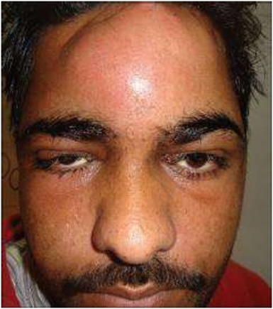
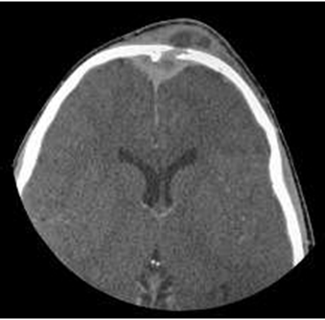
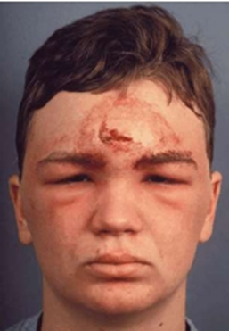

Slide 41
Symptomatology
Headache
Fever
Neurologic findings
Periorbital or frontal swelling
Nasal congestion, rhinorrhea

Slide 42
Conclusions
Complications are less common with antibiotics
Orbital
Intracranial
Bony
Can result in drastic sequelae
Drain abscess and open involved sinuses
Surgical involvement
Ophthalmology
Neurosurgery

